Slide 1
AUTOMATED VACCINATION SYSTEM
TEAM MEMBERS:
Ashwin K
Balaji S
Deepadharsan M
Dhanush G
1

Slide 2
Objective:
The website aims to assist people in getting vaccinated during the pandemic without risking exposure to the disease.
It allows a maximum of 10 members to access a specific center at day, eliminating the need for individual presence.
It sends email notifications for booking vaccinations and informs about any changes in vaccination center due to emergencies.
Additionally, it ensures eligibility for the second vaccination and maintains a history of previous vaccinations for users.
2

Slide 3
Existing System
The current system allows individuals to download vaccination e-certificates but lacks features such as booking appointments or checking vaccine availability.
It only provides information about vaccination center locations and does not indicate second dosage eligibility even if it's available
Existing website:- https://selfregistration.cowin.gov.in/
3

Slide 4
Problem Identified
Lack of Availability Checking
Lack of Booking Functionality
The website only displays available vaccination centers, but it doesn't show whether appointments are available at these centers.
Users can't book appointments at specific vaccination centers through the website. They can only download their vaccination certificates.
Absence of Real-Time Updates
Limited Functionalities
There's no system in place to provide real-time updates. Users won't receive notifications if there are sudden changes or emergencies at nearby vaccination centers.
It lacks essential features like indicating eligibility for the second vaccination and addressing issues such as vaccinating people during high case loads.
4

Slide 5
Proposed System
The proposed system is a user-centric website developed using the Node application, aiming to provide an enhanced user experience in the vaccination process.
It focuses on efficiently booking vaccination slots by checking availability and sending notifications via email to users.
The system not only focuses on making the vaccination process easy but also gives top importance to keeping patients' information safe and private.
It does this by using a special security feature called bcrypt to lock and protect their files from being accessed by unauthorized people.
5

Slide 6
Implementation Details
Front End | HTML | CSS | JavaScript
Back End | Node.js | Express.js | Node Mailer
Database | MongoDB
Tools | MongoDB compass | bcrypt | Outlook Mail Services
6

Slide 7
Results and Discussion
Efficient Booking System
Email Notifications
Enables users to book vaccination slots based on availability, ensuring a smoother and more streamlined process.
Notifies users about available slots, ensuring they stay informed and can schedule appointments promptly
Administrator Control
Infection Control Measures
Admins have the ability to update vaccination center details and dosages regularly, ensuring accurate and up-to-date information for users
Limits the number of people accessing the vaccination center to 10 members per day, reducing the risk of disease spread and maintaining safety protocols.
7

Slide 8
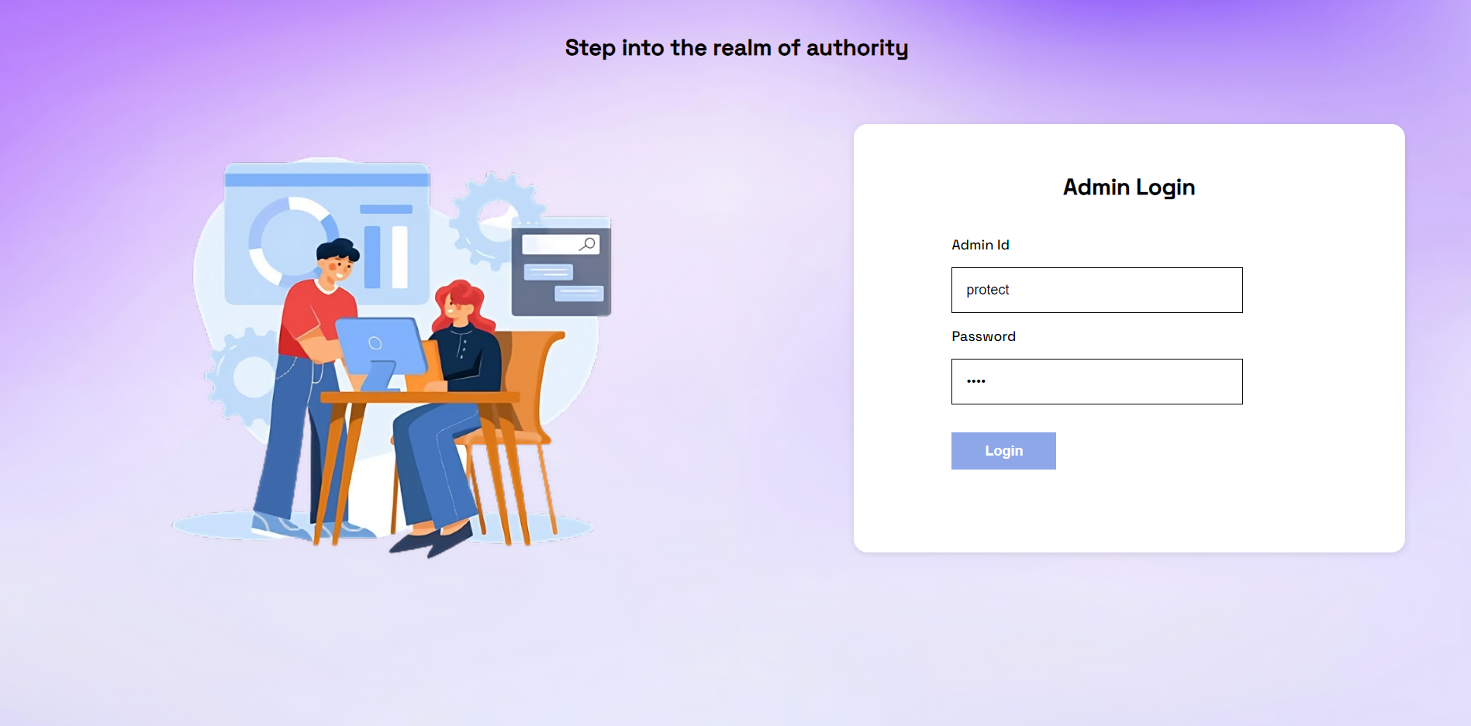
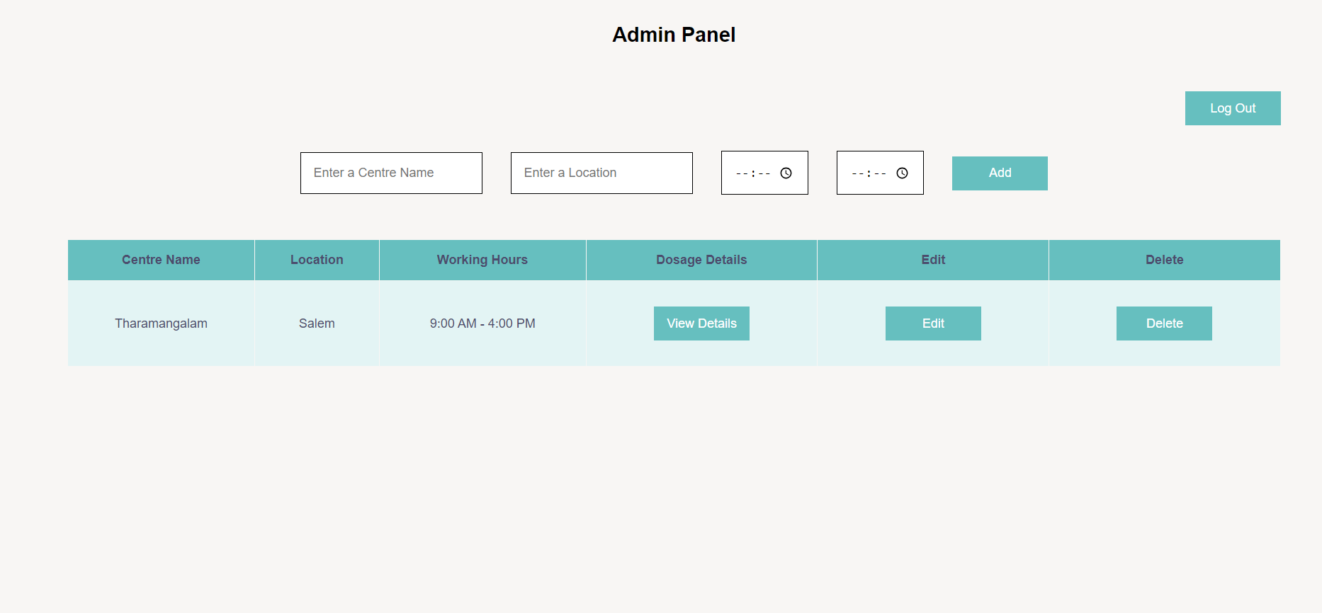
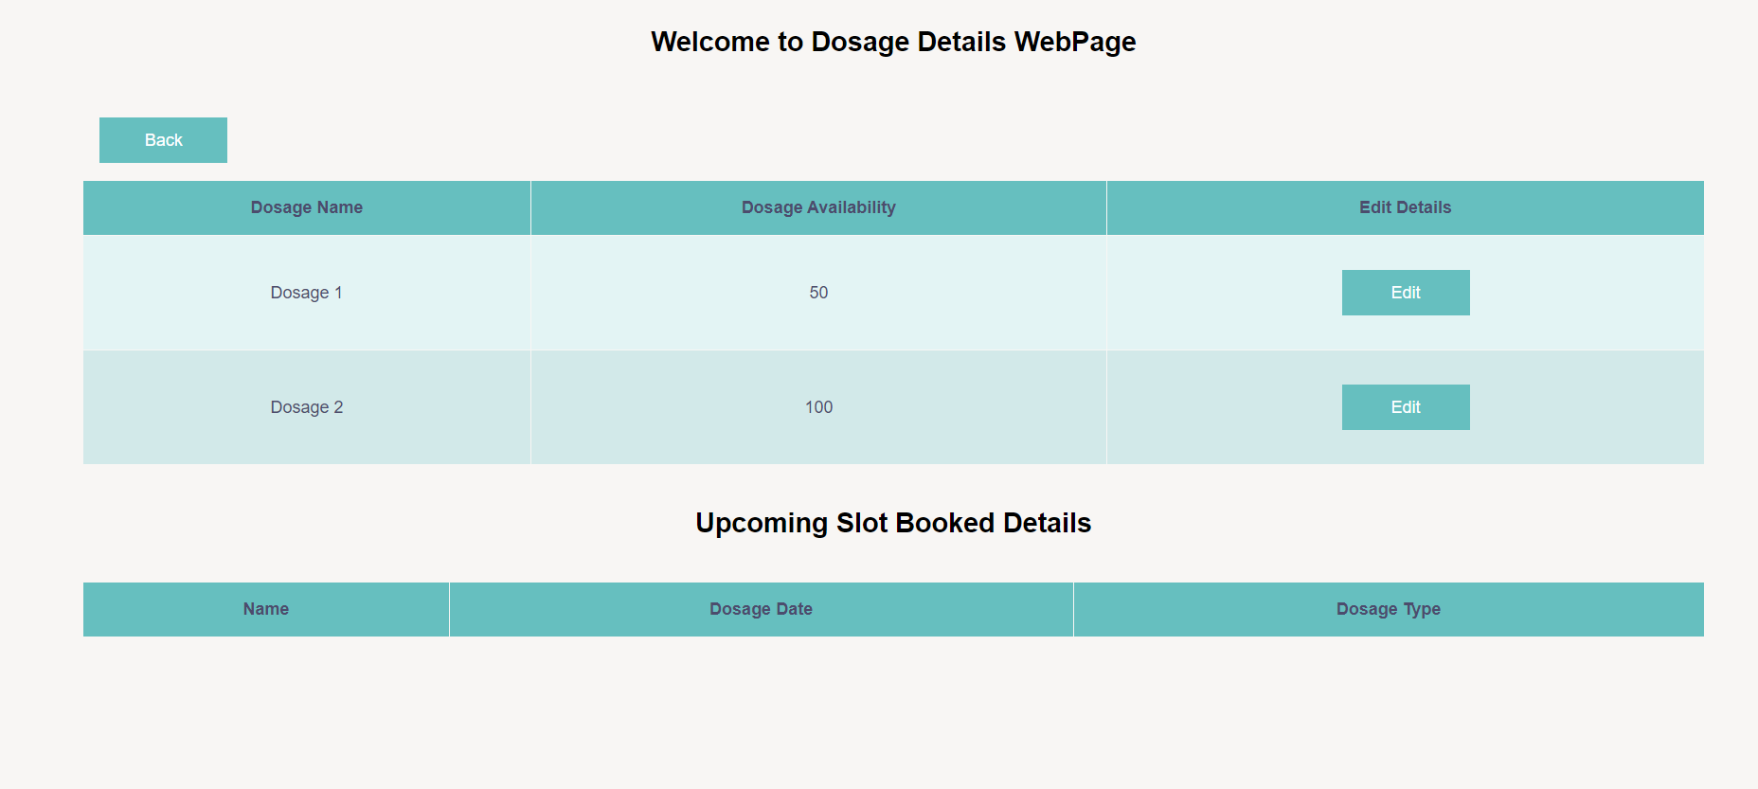
Sample Screen Shots (Admin Page)
8

Slide 9
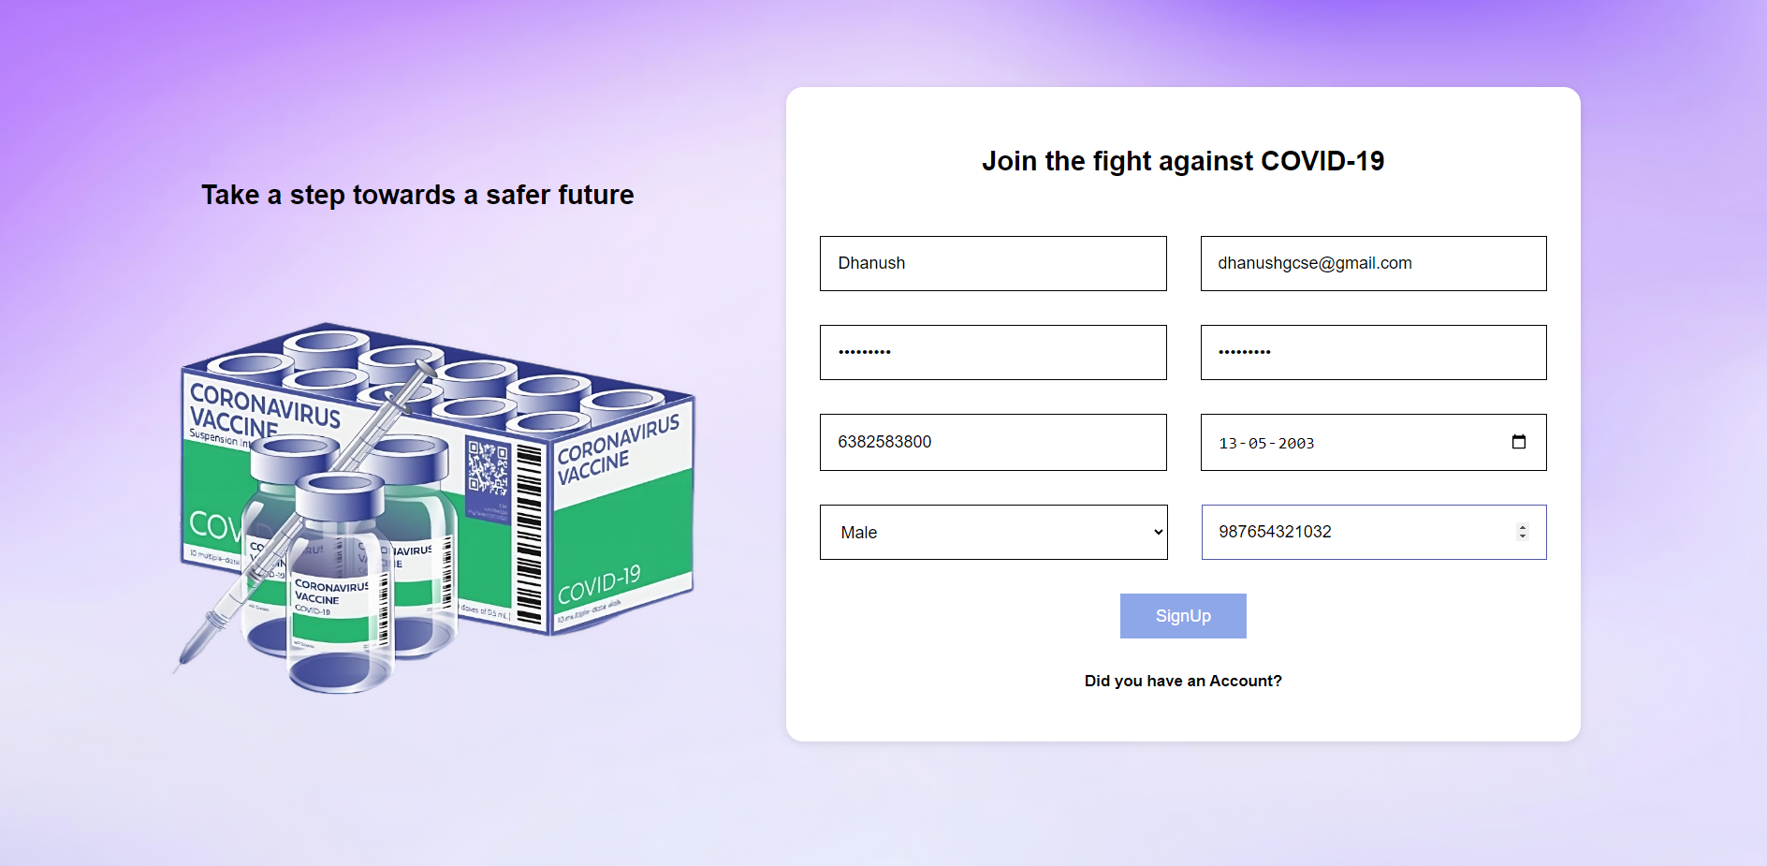
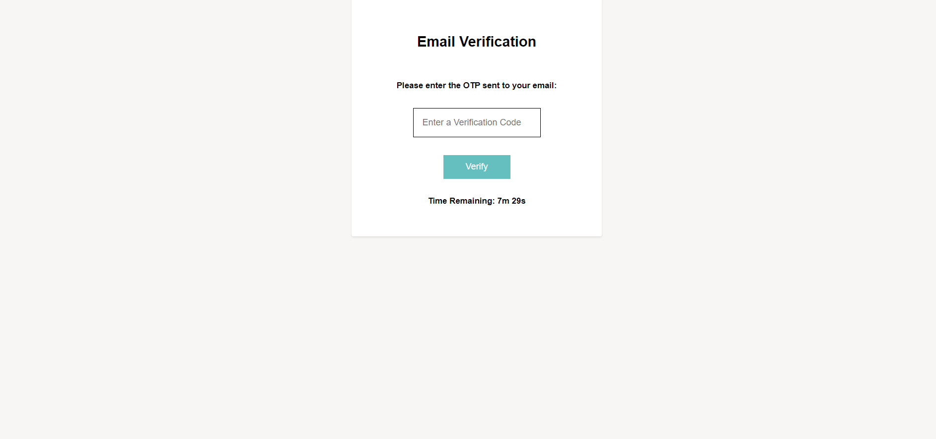
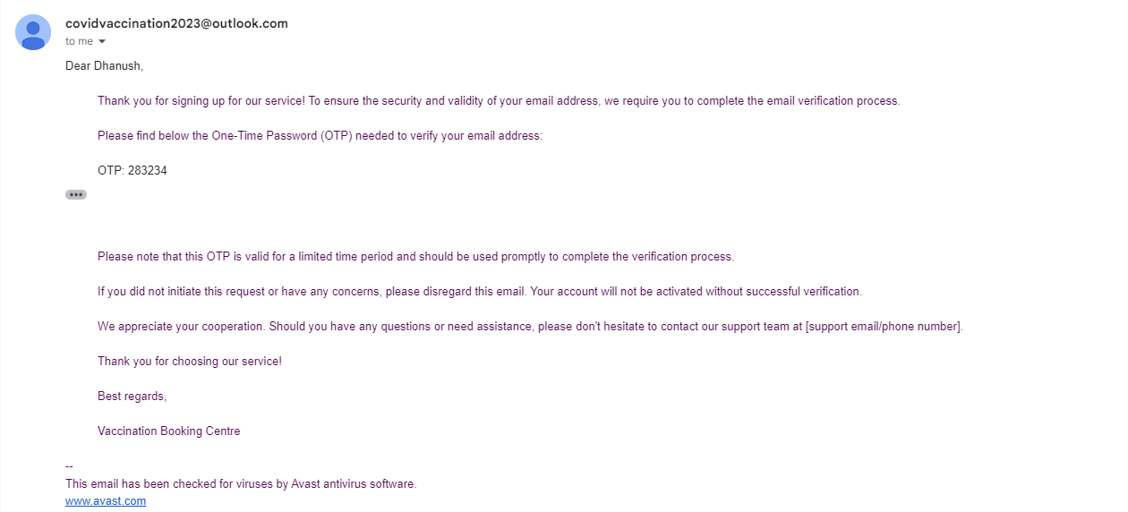
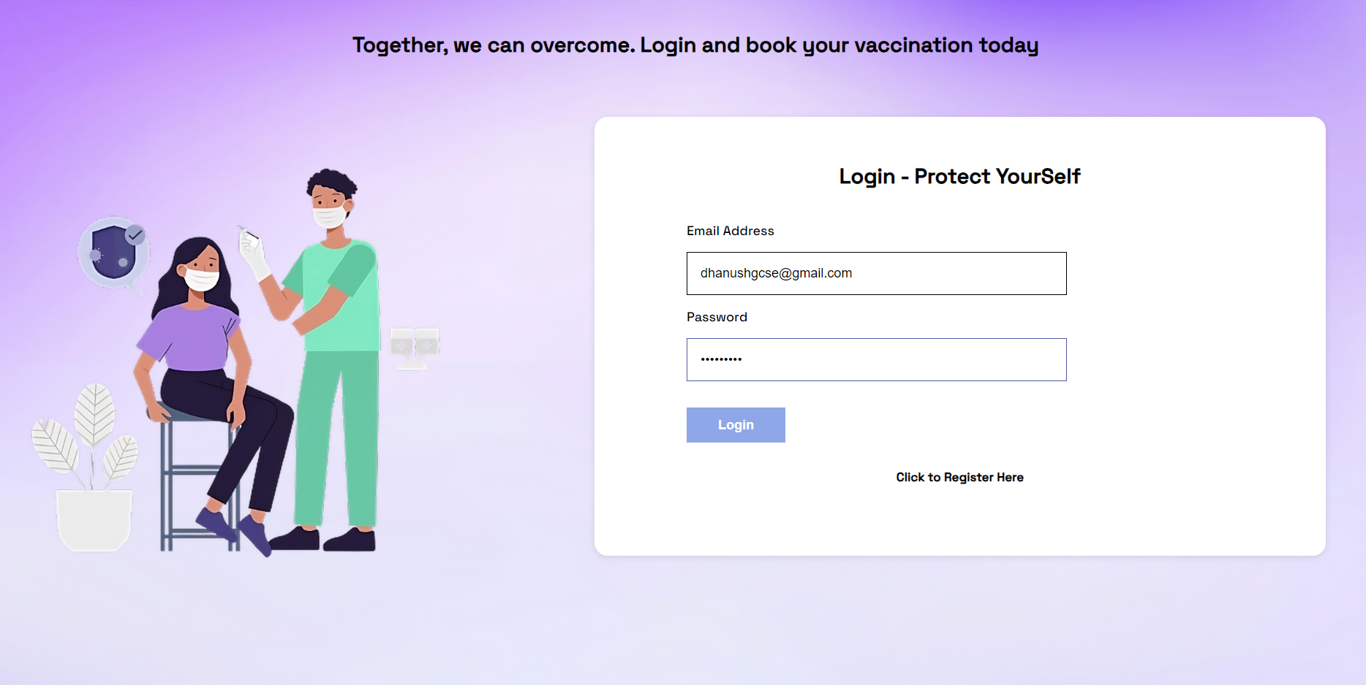
Sample Screen Shots (Signup Page)
9

Slide 10
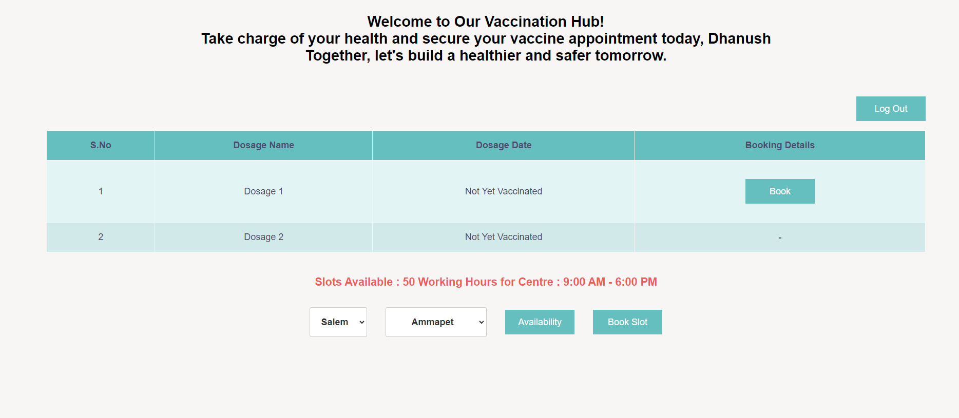
Sample Screen Shots (Home Page)
10

Slide 11
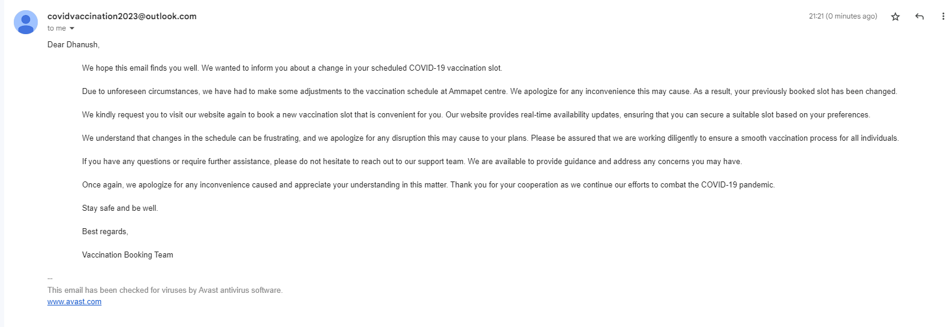
Sample Screen Shots (Mail)
11

Slide 12
Future Enhancements
Blockchain-Powered Secure Storage
Integration of Various Vaccination Systems
Comprehensive Encryption of Patient Details
Innovative Voice-Based Access for Accessibility
Advanced Visual Analytics for Enhancements
12

Slide 13

13

